Slide 1
UT Runtime/Systems PANDO Update

Slide 2
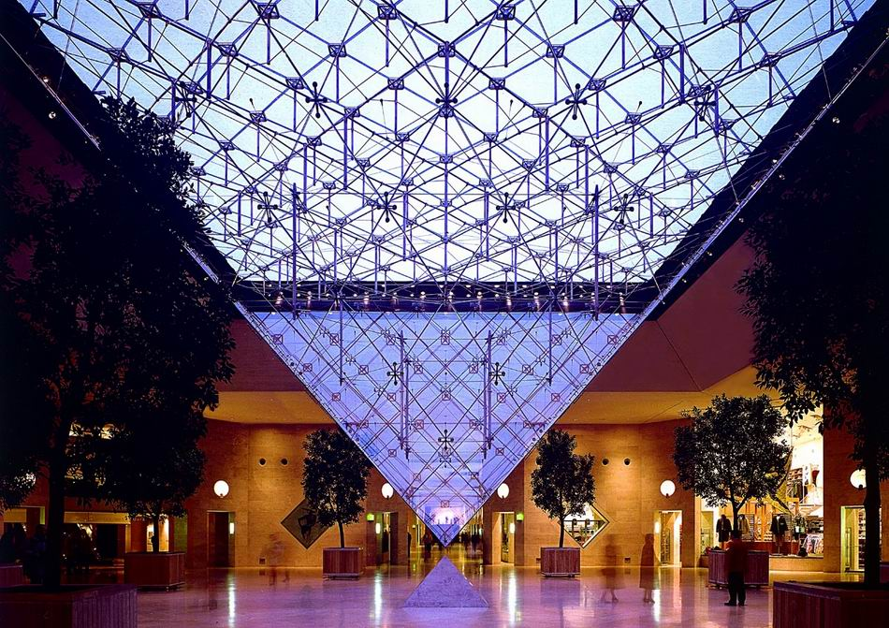
Galois system
Parallel program = Operator + Schedule + Parallel data structures
Ubiquitous parallelism:
small number of expert programmers (Stephanies) must support large number of application programmers (Joes)
cf. SQL
Galois system:
Stephanie: library of concurrent data structures and runtime system
Joe: application code in sequential C++
Galois set iterator for highlighting opportunities for exploiting ADP
Joe: Operator + Schedule
Stephanie: Parallel data structures
and runtime system

Slide 3
Hello graph Galois Program
#include “Galois/Galois.h”
#include “Galois/Graphs/LCGraph.h”
struct Data { int value; float f; };
typedef Galois::Graph::LC_CSR_Graph<Data,void> Graph;
typedef Galois::Graph::GraphNode Node;
Graph graph;
struct P {
void operator()(Node n, Galois::UserContext<Node>& ctx) {
graph.getData(n).value += 1;
}
};
int main(int argc, char** argv) {
graph.structureFromGraph(argv[1]);
Galois::for_each(graph.begin(), graph.end(), P());
return 0;
}
Data structure
Declarations
Operator
Galois Iterator

Slide 4
Parallel execution of Galois programs
Application (Joe) program
Sequential C++
Galois set iterator: for each
New elements can be added to set during iteration
Optional scheduling specification (cf. OpenMP)
Highlights opportunities in program for exploiting amorphous data-parallelism
Runtime system
Ensures serializability of iterations
Execution strategies
Speculation
Interference graphs
Multicore CPU or GPU
Application Program
Master thread
main()
….
for each …..{
…….
…….
}
.....
i₁
i₃
i₂
i₄
Workset
of active nodes
i₅
Graph
Concurrent
data structures
Notes:
Consistency vs isolation

Slide 5
Distributed Graph Analytics
Applications:
Datasets: unstructured graphs
Pathfinding
Recommendations
Searching
Centrality / Importance
Need TBs of memory
Credits: yola,edutopiaglobal.com slideshare, amazon.com
Credits: Sentinel Visualizer
Notes:
Graph analytics:
1. random memory access
2. unpredictable control flow

Slide 6
Vertex Programming Model
Every node has a label
e.g., distance in single source shortest path (SSSP)
Apply an operator on an active node in the graph
e.g., relaxation operator in SSSP
Push-style: reads its label and writes to neighbors’ labels
Pull-style: reads neighbors’ labels and writes to its label
Termination: no more active nodes (or work)
Applications: breadth first search, connected component, k-core, pagerank, single source shortest path, betweenness centrality, etc.
R
W
push-style
R
W
pull-style

Slide 7
Distributed Galois using Gluon
Programmers:
Write Galois/IrGL applications
Interface with Gluon using API
Gluon transparently handles:
Graph partitioning
Communication and synchronization
GPU
IrGL
Gluon Plugin
CPU
Gluon Comm. Runtime
Galois
CPU
Gluon Plugin
Gluon Comm. Runtime
Gluon Comm. Runtime
CuSP Partitioner
CuSP Partitioner
Network (LCI/MPI)
Network (LCI/MPI)
Galois [SoSP’13]
IrGL [OOPSLA’16]
LCI [IPDPS’18]
CuSP [IPDPS’19]
Notes:
Host-to-device and inter-host communication
API and plugin

Slide 8
Partitioning
Host h1
Host h2
B
C
A
D
F
G
E
H
I
J
Original graph
Partitions of the graph

Slide 9
Partitioning
Host h1
Host h2
Each edge is assigned to a unique host
B
C
A
D
F
G
E
H
I
J
Original graph
Partitions of the graph

Slide 10
Partitioning
Host h1
Host h2
Each edge is assigned to a unique host
All edges connect proxy nodes on the same host
B
C
B
C
B
C
D
A
D
A
F
G
F
G
F
G
E
H
E
H
I
J
I
J
J
Original graph
Partitions of the graph

Slide 11
Partitioning
Host h1
Host h2
Each edge is assigned to a unique host
All edges connect proxy nodes on the same host
A node can have multiple proxies: one is master proxy; rest are mirror proxies
B
C
B
C
B
C
D
A
D
A
F
G
F
G
F
G
E
H
E
H
I
J
I
J
J
: Master proxy
: Mirror proxy
Original graph
Partitions of the graph

Slide 12
How does Gluon synchronize the proxies?
Exploit domain knowledge
Cached copies can be stale as long as they are eventually synchronized
Host h1
Host h2
1
8
B
C
B
C
0
A
8
D
F
G
F
G
1
8
E
8
H
I
J
J
: Master proxy
: Mirror proxy
: distance (label) from source A

Slide 13
How does Gluon synchronize the proxies?
Exploit domain knowledge
Cached copies can be stale as long as they are eventually synchronized
Use all-reduce:
Reduce: mirror proxies to master proxy
Broadcast: master to mirror proxies
Host h1
Host h2
1
B
C
B
C
0
8
A
1
D
F
G
F
G
1
1
E
8
H
I
J
J
: Master proxy
: Mirror proxy
: distance (label) from source A

Slide 14
Gluon Distributed Execution Model
Host h1
Host h2
Gluon partitioner
Gluon partitioner
Galois/CPU IrGL/CUDA on GPU
Galois/CPU
IrGL/CUDA on GPU
Gluon comm. runtime
MPI/LCI
MPI/LCI
Gluon comm. runtime
Galois [SoSP’13]
Ligra [PPoPP’13]
IrGL [OOPSLA’16]
LCI [IPDPS’18]

Slide 15
Log Structured CSR
Key ideas
CSR: great read performance, poor write performance
Log-structure →
preserves read locality for evolving CSR
Append-only writes → better write performance
Key questions
Representation for topology
Representation for properties
Synchronization design

Slide 16
Background: LPGs
Labeled property graphs
TBD
Notes:
Add text for what is what; add animations if time

Slide 17
Background: CSR
CSR is an efficient way to represent sparse graphs
But not efficiently updateable
Represents topology only
Compressed Sparse Row
Vertex Array
Edge Array
Goals:
Increase cache-ability of graph
Represent sparse data efficiently
We need to cover adding properties
0
CSR
0
1
2
3
09-15;
2,000,000
2
1
1
2
3
Notes:
Add text for what is what; add animations if time

Slide 18
Background: EL
Edgelist
Efficiently updatable
Poor locality for read-dominated workloads
Morph Graph: a fast EL variant
Exponential growth of edge list arrays instead of linked lists
Trade memory for locality, amortize allocation overheads

Slide 19
Ingesting Updates
Evolving graphs evolve
So our structure needs to accommodate these changes
Changes to Understand:
Adding a Node
Adding an Edge
Batch additions
Topology updates: additions only
Deletions are trivial to support but not needed
Updates: delete → add, but also not needed

Slide 20
Adding a Node
Vertex Addition is fast:
append to the Vertex Array
(vertex ids implicit)
(already fast with CSR)
Global ID | Local ID
805674 | 0
8596874 | 1
789565 | 2
56444564 | 3
0
1
2
4
6
0
3
0
0
1
0
2
2
1
3
Global ID | Local ID
805674 | 0
8596874 | 1
789565 | 2
56444564 | 3
56465 | 4
0
1
2
4
6
7
4
3
0
0
1
0
2
3
Notes:
Change all blue things to grey (you think it is green)

Slide 21
Adding an Edge
0
1
2
4
6
Adding to the edge array usually requires shifting
Worst case copies the entire edge array
0
3
0
0
1
0
2
Requires Recreating the CSR
2
1
3
0
1
3
5
7
3
0
2
0
1
0
2

Slide 22
Log Structured CSR
Edge Addition is easier with an explicit edge list
Idea: turn all updates into appends
Implementation:
Add edge → copy updated edge list to end of edge array
Previous Edges are tomb-stoned
Problem: edge lists / neighbor vertices no longer contiguous
Solution: Store edge start/end in a vertex entry
0
0,1
1,2
2,4
4,6
2
1
3
0
0
1
0
2
3
Notes:
Re-label the edges to make this hard

Slide 23
Log Structured CSR
Edge Addition is easier with an explicit edge list
Idea: turn all updates into appends
Implementation:
Add edge → copy updated edge list to end of edge array
Previous Edges are tomb-stoned
Problem: edge lists / neighbor vertices no longer contiguous
Solution: Store edge start/end in a vertex entry
0,1
1,2
2,4
4,6
0
3
0
0
1
0
2
2
1
3
0,1
6,8
2,4
4,6
3
0
0
1
0
2
0
3
Notes:
Re-label the edges to make this hard

Slide 24
Design Alternatives: Log Structured CSR Variants
Benchmarking Variants shows how Packing Data within the CSR representation performs.
Vertex and Edge Handle Alternatives
LS_CSR with Out of Line Locking (separate lock array)
LS_CSR with Packed Values for Locking (locks steal bits from IDs)
Representing Properties
LS_CSR with Out of Line Properties (properties in separate arrays)
LS_CSR with Packed Edge Properties
LS_CSR with Packed Node Properties
LS_CSR with both Packed Properties
PANDO: properties in DKV store (e.g. Memcached)
Hypothesis: best representation depends on level of heterogeneity

Slide 25
Methodology
Workloads:
Single-Source Shortest Path (BFS)
Jaccard Similarity
Underlying Structure:
Morph Graph (Galois’ Resident EdgeList)
Regular CSR -> recomputed on each edit
Log Structured CSR variants
Update intensity:
No Edits
n/8 of the Graph ingested
Metrics of Interest:
Total Cycles
Cycles spent Editing
Cycles spent on Workload
Micro-arch counters collected will be on auxiliary slides
Sequential only
Hardware
14 Core 2.90 GHz Intel(R) Xeon(R) CPU E5-2680 v4
Frequency scaling disabled
SMT disabled
L1d 32KiB per core
L1i 32KiB per core
L2 250KiB per core
L3 35 MiB Unified
1 NUMA Node
GCC (G++) 9.4.0
O2
Inputs
Yelp: 13954819 edges, 716847 nodes
Citeseer: 4676 edges, 3326 nodes
Cora: 5278 edges, 2708 nodes

Slide 26
Deleting an Edge
Idea: Steal a bit to Tombstone in the Edge (Shown by black interior)
0,1
1,2
2,4
4,6
0
3
0
0
1
0
2
2
1
3
0,1
1,2
2,4
4,6
The edge will still be traversed, just ignored
3
0
0
1
0
2

Slide 27
Deleting a Node
Idea: Steal a bit to Tombstone in the Node (Shown by black interior)
0,1
1,2
2,4
4,6
0
3
0
0
1
0
2
2
1
3
0,1
1,2
2,4
4,6
Edges sourced at 2 are now unreachable
Edges traversals with a destination of 2 must check
3
0
0
1
0
2
Notes:
Actually put a tombstone

Slide 28
Aside about Labeled Properties
CSR can easily query a labeled property Key-Value Store
Properties for nodes are keyed using their index in the Vertex array Properties for edges are keyed by using both the source index and destination index.
This is preserved in our semantics assuming no duplicate edges.

Slide 29
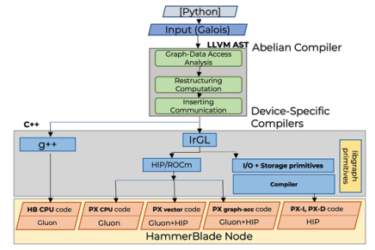
PANDO Compiler Toolchain
Galois programming model
Parallel patterns
Concurrent data structures
LLVM-based backend
CPU binaries
S2S → CUDA, ROCm, OpenCL
BSP+MPI execution model
Multiple Layers of Compilers
IrGL: Galois->Accelerators
Abelian: Galois->BSP+CUSP

Slide 30
Gluon API
Gluon[PLDI’18] provides efficient high level bulk synchronous API for synchronization:
A communication substrate to build distributed and heterogeneous graph analytics systems
Provides:
Graph partitioner (Edge-cuts and Vertex-cuts)
Communication-optimized runtime:
Exploits partitioning structural invariants
Avoids sending unnecessary meta-data
Abelian required:
To insert Gluon API calls for distributed execution
Provide information to exploit Gluon optimization
GPU
IrGL/CUDA/...
Gluon Plugin
CPU
Gluon Comm. Runtime
Galois/Ligra/...
CPU
Gluon Plugin
Gluon Comm. Runtime
Gluon Comm. Runtime
Partitioner
Partitioner
Network (LCI/MPI)
Network (LCI/MPI)
Galois [SoSP’13]
Ligra [PPoPP’13]
IrGL [OOPSLA’16]
LCI [IPDPS’18]

Slide 31
Shared Memory Galois PageRank (Input)
struct pageRank() {
Graph* g
pageRank(Graph* g) : g(g) {}
void operator()(GNode src, Worklist& wl) {
auto& srcData = g->getData(src);
auto residual_old = srcData.residual.exchange(0);
srcData.rank += residual_old;
auto delta = residual_old*alpha/srcData.nout;
for(auto e : g->getEdges(src)) {
GNode dst = g->getEdgeDst(e);
auto& dstData = g->getData(dst);
dstData.residual += delta;
if(dstData.residual > tolerance) {
wl.push(dst);
}
}
}
}
while (!wl.empty()) { Galois::do_all(wl, pageRank{&g}; }
Graph node labels:
rank, residual, nout
Asynchronous execution
Push-style operator
Update residual on immediate neighbors
Work-list based
Apply operator to items in work-list
Push new active nodes to work-list
Notes:
Animation in the code.
Include do_all
And node attributes
Just this much code….. Simple code + compiler will handle everything
nothing distributed , nothing device specific;… don’t read the code + this is all the code

Slide 32
Distributed Heterogeneous PageRank (Output)
do{
Galois:do_all (graph.getSources(), pageRank{&graph, alpha, tolerance});
Flag_rank.set_writeSrc();
Flag_contrib.set_reduceDst();
If(Flag_contrib.is_reduceDst()) {
graph.sync<reduceDst, readSrc, Add_contrib, Bcast_contrib>(Bitvec_contrib);
Flag_contrib.reset_reduceDst();
} else if (Flag_contrib.is_reduceDst()) {
…
} else { … }
Galois:do_all (graph.getSources(), pageRank_split{&graph});
Flag_residual.set_writeSrc();
}while(work_done.reduce());
struct pageRank() {
Graph* g
pageRank(Graph* g) : g(g) {}
DistributedAcc work_done;
void operator()(GNode src,
Worklist& wl) {
if(srcData.residual > tolerance) {
…
for(auto e : g->getEdges(src)) {
…
dstData.contrib += delta;
}
}}
struct pageRank_split() {
Graph* g;
void operator()(GNode src) {
auto& srcData = g->getData(src);
srcData.residual += srcData.contrib;
srcData.contrib = 0;
}
Graph node labels:
rank, residual, nout, contrib
BSP style execution
Operators:
pageRank and pageRank_split
Filter-based data-driven
On-demand communication
Gluon sync calls

Slide 33
Input to output
Code Transformations:
Required transformation
Asynchronous to BSP style of execution
Closure conversion for heterogeneous execution
Optimization transformation
Work-list elimination
Communication optimizations:
On-demand communication
Fine-grain synchronizations

Slide 34
Code Transformations

Slide 35
Asynchronous to BSP Execution
Fine-grain synchronization needed
Reading and writing residual at source
Updating residual at destination on immediate neighbors
BSP execution does not permit fine grain synchronization
Hosts see different values during computation phase due to disjoint address space
Requires synchronization
struct pageRank() {
Graph* g
pageRank(Graph* g) : g(g) {}
void operator()(GNode src, Worklist& wl) {
auto& srcData = g->getData(src);
auto residual_old = srcData.residual.exchange(0);
srcData.rank += residual_old;
auto delta = residual_old*alpha/srcData.nout;
for(auto e : g->getEdges(src)) {
GNode dst = g->getEdgeDst(e);
auto& dstData = g->getData(dst);
dstData.residual += delta;
if(dstData.residual > tolerance) {
wl.push(dst);
}
}
}

Slide 36
Restructuring Computation: Required Transformation 1
Fine-Grain iteration-level to round based BSP
Splitting operator:
PageRank: read and write access
PageRank_split: reduction
Introduce new variables (contrib)
struct pageRank() {
Graph* g;
float &local_alpha, &local_tolerance
pageRank(Graph* g) : g(g) {}
void operator()(GNode src, Worklist& wl) {
auto& srcData = g->getData(src);
auto residual_old = srcData.residual.exchange(0);
srcData.rank += residual_old;
auto delta = residual_old*local_alpha/srcData.nout;
for(auto e : g->getEdges(src)) {
GNode dst = g->getEdgeDst(e);
auto& dstData = g->getData(dst);
dstData.contrib += delta;
if(dstData.contrib > local_tolerance) {
wl.push(dst);
}
} }
struct pageRank_split() {
Graph* g;
pageRank_split(Graph* g) : g(g) {}
void operator()(GNode src) {
auto& srcData = g->getData(src);
srcData.residual += srcData.contrib;
srcData.contrib = 0;
}

Slide 37
Transformations for Heterogeneous Execution
Global variables present
tolerance and alpha
Heterogenous hosts may not share common visible memory space
struct pageRank() {
Graph* g
pageRank(Graph* g) : g(g) {}
void operator()(GNode src, Worklist& wl) {
auto& srcData = g->getData(src);
auto residual_old = srcData.residual.exchange(0);
srcData.rank += residual_old;
auto delta = residual_old*alpha/srcData.nout;
for(auto e : g->getEdges(src)) {
GNode dst = g->getEdgeDst(e);
auto& dstData = g->getData(dst);
dstData.contrib += delta;
if(dstData.contrib > tolerance) {
wl.push(dst);
}
}
}

Slide 38
Restructuring Computation: Required Transformation 2
Eliminating global variables:
Make operators self contained (closure conversion)
Introduce corresponding local variables
struct pageRank() {
Graph* g;
float &local_alpha, &local_tolerance
pageRank(Graph* g) : g(g) {}
void operator()(GNode src, Worklist& wl) {
auto& srcData = g->getData(src);
auto residual_old = srcData.residual.exchange(0);
srcData.rank += residual_old;
auto delta = residual_old*local_alpha/srcData.nout;
for(auto e : g->getEdges(src)) {
GNode dst = g->getEdgeDst(e);
auto& dstData = g->getData(dst);
dstData.contrib += delta;
if(dstData.contrib > local_tolerance) {
wl.push(dst);
}
} }
Local Variables

Slide 39
Optional Optimization Transformation
Work-list elimination Optimization
Distributed work-list required
Needs synchronization
struct pageRank() {
Graph* g;
float &local_alpha, &local_tolerance
pageRank(Graph* g) : g(g) {}
void operator()(GNode src, Worklist& wl) {
auto& srcData = g->getData(src);
auto residual_old = srcData.residual.exchange(0);
srcData.rank += residual_old;
auto delta = residual_old*local_alpha/srcData.nout;
for(auto e : g->getEdges(src)) {
GNode dst = g->getEdgeDst(e);
auto& dstData = g->getData(dst);
dstData.contrib += delta;
if(dstData.residual > local_tolerance) {
wl.push(dst);
}
} }

Slide 40
Restructuring Computation: Optimization Transformation
Conversion to filter based data-driven algorithm:
Avoid distributed work-list synchronization overhead
Conditional used to push work is used to filter
struct pageRank() {
Graph* g;
float &local_alpha, &local_tolerance
pageRank(Graph* g) : g(g) {}
void operator()(GNode src, Worklist& wl) {
auto& srcData = g->getData(src);
if(srcData.residual > local_tolerance) {
auto residual_old = srcData.residual.exchange(0);
srcData.rank += residual_old;
auto delta = residual_old*local_alpha/srcData.nout;
for(auto e : g->getEdges(src)) {
GNode dst = g->getEdgeDst(e);
auto& dstData = g->getData(dst);
dstData.contrib += delta;
}
}

Slide 41
Analysis and Inserting communication
Notes:
1. After doing the required transformations, we will now look at how compiler analyses the code and inserts the communication for distributed execution

Slide 42
Information Required by Gluon Synchronization API
Application-specific:
What: Field to synchronize
When: Point of synchronization
How: Reduction operator to use
Optional information for optimization:
Field specific bit-set to track updated fields
Precise read and write locations for exploiting structural invariant optimization

Slide 43

Graph-Data Access Analysis
Input
Galois
Fields accessed on graph Nodes (What)
Operator field access types (How) :
Reduction: Field is read and updated using reduction operation (inside edge iterator)
Read: Field is only read
Write: Field is written (not part of a reduction)
Operator field access location:
At source: At the source of an edge
At destination: At the destination of an edge
At any: At the node or both end points of edge
LLVM AST
Abelian
Compiler
Graph-Data Access Analysis
Restructuring Computation
Inserting Communication
Device Specific
Compilers
C++
g++
IrGL
CUDA
OpenCL
CPU code
GPU code
Gluon Runtime
Gluon Runtime

Slide 44
PageRank Example
Field accessed: contrib, residual, rank
Reduction operation (contrib): +=
Field accessed location:
residual and rank
Read at source
contrib
Updated at destination
struct pageRank() {
Graph* g;
float &local_alpha, &local_tolerance
pageRank(Graph* g) : g(g) {}
void operator()(GNode src, Worklist& wl) {
auto& srcData = g->getData(src);
if(srcData.residual > local_tolerance) {
auto residual_old = srcData.residual.exchange(0);
srcData.rank += residual_old;
auto delta = residual_old*local_alpha/srcData.nout;
for(auto e : g->getEdges(src)) {
GNode dst = g->getEdgeDst(e);
auto& dstData = g->getData(dst);
dstData.contrib += delta;
}
}

Slide 45
Inserting Communication
Input
Galois
LLVM AST
Abelian
Compiler
Graph-Data Access Analysis
Restructuring Computation
Inserting Communication
Device Specific
Compilers
C++
g++
IrGL
CUDA
OpenCL
CPU code
GPU code
Gluon Runtime
Gluon Runtime
Notes:
Now let’s look at how Abelian inserts communication

Slide 46
Inserting Naïve Communication: UnOptimized PageRank
Inserting Gluon sync API calls
struct pageRank() {
Graph* g;
float &local_alpha, &local_tolerance
pageRank(Graph* g) : g(g) {}
void operator()(GNode src, Worklist& wl) {
…
}
}
while(!workDone){
Galois:do_all (graph.getSources(), pageRank{&graph, alpha, tol});
graph.sync<reduceAny, readAny, Add_contrib, Bcast_contrib>();
Galois:do_all (graph.getSources(), pageRank_split{&graph});
graph.sync<reduceAny, readAny, Add_residual, Bcast_residual>();
}
struct pageRank_split() {
Graph* g;
pageRank_split(Graph* g) : g(g) {}
void operator()(GNode src) {
…
}
}

Slide 47
Communication optimizations Optimization 1:
PageRank Operator
Contrib updated
Naïve synchronization:
Conservative approach
contrib updated in pageRank operator
PageRank_split Operator
Contrib read
Data flow diagram
Contrib variable

Slide 48
Communication optimizations Optimization 1:
PageRank Operator
Contrib updated
Sync contrib
Naïve synchronization:
Conservative approach
contrib updated in pageRank operator
Sync contrib after pageRank operator
PageRank_split Operator
Contrib read
Data flow diagram
Contrib variable

Slide 49
Communication optimizations Optimization 1:
PageRank Operator
Contrib updated
On-demand synchronization:
Only sync before operator if required
Sync before using contrib on-demand in pageRank_split before reading
PageRank_split Operator
Contrib read
Sync contrib
Data flow diagram
Contrib variable

Slide 50
Communication optimizations Optimization 1:
Inserting on-demand communication:
Field specific sync-state flags
Before operator:
Checks sync-state flags with precise read/write location provided by Abelian
Calls Gluon sync if required.
After operator:
Inserts code to set or invalidate field-specific sync-state flags (uses write location)
Notes:
Additional information from Abelian:
Abelian precisely identifies abstract read and write location
Exploits Gluon’s structural invariant optimization

Slide 51
Inserting On-demand Communication: PageRank example
Inserting on-demand communication
Insert and Set sync flags
Check sync flags and insert Gluon sync calls
Galois:do_all (graph.getSources(), pageRank{&graph,
alpha, tolerance});
Flag_rank.set_writeSrc();
Flag_contrib.set_reduceDst();
If(Flag_contrib.is_reduceDst()) {
graph.sync<reduceDst, readSrc, Add_contrib,
Bcast_contrib>(Bitvec_contrib);
Flag_contrib.reset_reduceDst();
} else if (Flag_contrib.is_reduceDst()) {
…
} else { … }
Galois:do_all (graph.getSources(), pageRank_split{&graph});
Flag_residual.set_writeSrc();
Notes:
1. It adds extra logic to check and set/invalidate sync flags

Slide 52
A Compiler for Throughput Optimization of Graph Algorithms on GPUs
Sreepathi Pai Keshav Pingali
The University of Texas at Austin
November 16, 2016

Slide 53
Outline
Approaches to Graph Algorithms on GPUs
IrGL Compiler and Optimizations
Bottleneck #1: Atomics
Bottleneck #2: Inner-loop Serialization
Bottleneck #3: Short Kernel Launches
Results
Performance Models for Graph Algorithms on GPUs

Slide 54
Approaches to Graph Algorithms on GPUs

Slide 55
Graph Algorithms on GPUs
GPUs excel on regular data-parallel code
e.g. Matrix Multiply
Graph algorithms on GPUs?
Good: Require lots of bandwidth
GPU memory bandwidth is 288GB/s
CPU memory bandwidth is 25GB/s
Bad: Data-parallel, but not regular

Slide 56
Approach #1: CUDA/OpenCL Implementations
Breadth-First Search (BFS) [Merrill et al., 2012]
Connected Components (CC) [Soman et al., 2010]
Delaunay Mesh Refinement (DMR) [Nasre et al., 2013]
Maximal Independent Set (MIS) [Che et al., 2013]
Minimum Spanning Tree (MST) [da Silva Sousa et al. 2015]
PageRank (PR) [Elsen and Vaidyanathan, 2014]
Single-Source Shortest Path (SSSP) [Davidson et al. 2014]
Triangle Counting (TRI) [Polak et al. 2015]

Slide 57
Approach #2: Graph Analytics Frameworks
C++ Template-based Frameworks
VertexAPI2 [Elsen and Vaidyanathan, 2014]
MapGraph [Fu et al, GRADES 2014]
Gunrock [Wang et al., PPoPP 2016]
Targeted towards graph analysts
Restricted to limited set of algorithms
Vertex programs
Immutable graphs

Slide 58
Our Approach: IrGL Compiler
Start from a high-level description of algorithm
Use optimizing compiler to generate CUDA
Advantages
Raises abstraction level for programmers
Does not sacrifice performance
Allows automatic exploration of optimizations
Road networks often require different optimizations compared to social networks

Slide 59
Example: Level-by-Level BFS
0
1
1
1
2
2
2
2
2
2
Kernel bfs(graph, LEVEL)
ForAll(node in Worklist)
ForAll(edge in graph.edges(node))
if(edge.dst.level == INF)
edge.dst.level = LEVEL
Worklist.push(edge.dst)
src.level = 0
Iterate bfs(graph, LEVEL) [src] { LEVEL++ }

Slide 60
Importance of Optimizations
Unoptimized Kernel
~15 lines of CUDA
505ms on USA road network graph
Optimized Kernel
~200 lines of CUDA
120ms on the same graph
4.2x Performance Difference!

Slide 61
IrGL Compiler and Optimizations

Slide 62
IrGL Constructs
Representation for irregular data-parallel algorithms
Parallelism
ForAll
Synchronization
Atomic
Exclusive
Worklist Management
Iterate
Pipe

Slide 63
IrGL Synchronization Constructs
Atomic: Blocking atomic section Atomic (lock) { critical section }
Exclusive: Non-blocking, atomic section to obtain multiple locks with priority for resolving conflicts Exclusive (locks) { critical section }

Slide 64
IrGL Worklist Construct: Pipe
Pipe allows multiple kernels to share the same worklist
All items pushed by a kernel are forwarded to the next (dynamic) kernel
Pipe is a general form of Iterate on worklists
Pipe { // input: bad triangles // output: new triangles Invoke refine_mesh(...)
// check for new bad tri. Invoke chk_bad_tri(...) }
refine_mesh
not worklist.empty()
chk_bad_tri

Slide 65
IrGL Compiler
Converts IrGL abstract syntax trees to CUDA
Generated CUDA code can be embedded into larger programs
IrGL intended for writing kernels, not full programs
IrGL compiler implemented as a library
Python-callable
IrGL ASTs are valid Python programs

Slide 66
Bottleneck #1: Atomics
Kernel bfs(graph, LEVEL)
ForAll(node in Worklist)
ForAll(edge in graph.edges(node))
if(edge.dst.level == INF)
edge.dst.level = LEVEL
Worklist.push(edge.dst)
src.level = 0
Iterate bfs(graph, LEVEL) [src] { LEVEL++ }
pos = atomicAdd(Worklist.length, 1)
Worklist.items[pos] = edge.dst
Atomic Throughput on GPU: 2.4GB/s
Memory bandwidth: 288GB/s

Slide 67
Reducing Atomics by Aggregation
atomicAdd(..., 5)
atomicAdd(..., 1)
Write
Thread
Thread

Slide 68
Handling Conditional Pushes
if(edge.dst.level == INF)
Worklist.push(edge.dst)
...
Time

Slide 69
Aggregation in GPUs
Intra-Warp
...
Lockstep execution, easily aggregated
0
31
Intra-Thread Block
...
...
...
...
0
31
64
95
32
63
Barrier required, so trickier to aggregate in conditionals

Slide 70
Warp-level Aggregation
Kernel bfs_kernel(graph, ...)
ForAll(node in Worklist)
ForAll(edge in graph.edges(node))
if(edge.dst.level == INF)
...
start = Worklist.reserve_warp(1)
Worklist.write(start, edge.dst)

Slide 71
Inside reserve_warp
(assume a warp has 8 threads)
T0 | T1 | T2 | T3 | T4 | T5 | T6 | T7
1 | 0 | 1 | 1 | 0 | 1 | 1 | 0
size
(warp prefix sum)
T0 | T1 | T2 | T3 | T4 | T5 | T6 | T7
0 | 1 | 1 | 2 | 3 | 3 | 4 | 5
_offset
T0: pos = atomicAdd(Worklist.length, 5) broadcast pos to other threads in warp
return pos + _offset

Slide 72
Thread-block Aggregation?
Kernel bfs(graph, ...)
ForAll(node in Worklist)
ForAll(edge in graph.edges(node))
if(edge.dst.level == INF)
start = Worklist.reserve_tb(1)
Worklist.write(start, edge.dst)
reserve_tb contains a CUDA barrier
All threads in thread block must execute barrier
But:
if(edge.dst.level == INF) is not uniform
ForAll(edge …) is not uniform

Slide 73
Uniform Branches
Uniform Branch
A branch that is decided the same way by all threads [in scope of a barrier]
Uniform If
All threads decide the condition the same way
Uniform While, For
All threads execute same number of iterations

Slide 74
Uniform Branches to Focal Points
A barrier is placed correctly if it is control-dependent only on uniform branches
A focal point is a node in the control-flow graph (CFG) that is iteratively control-dependent only on uniform branches, other than possibly itself.
Use the control-dependence graph (CDG) to identify focal points

Slide 75
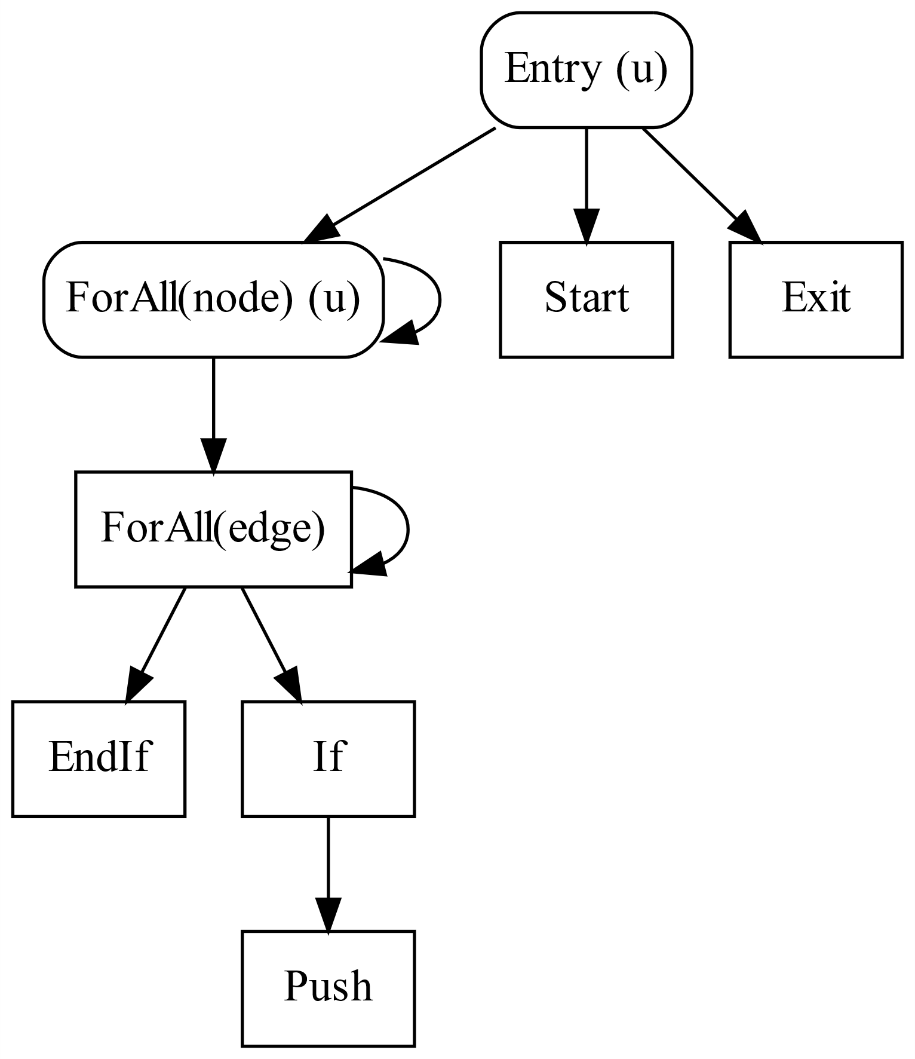
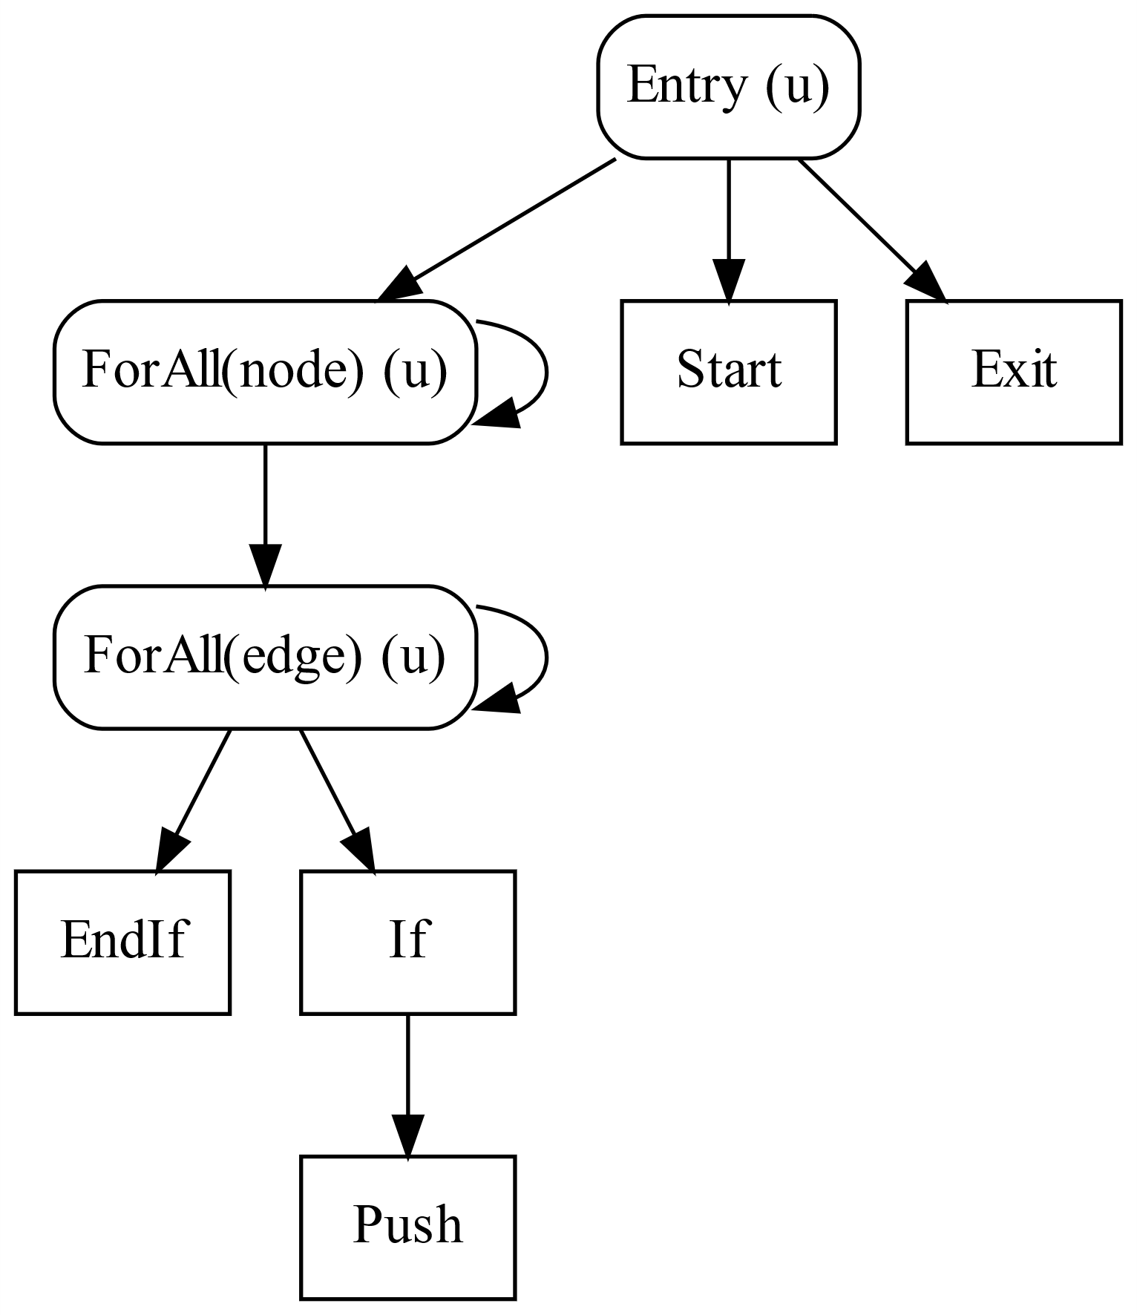
Focal Points from the CDG

Slide 76
reserve_tb placed
Kernel bfs(graph, ...)
ForAll(node in Worklist)
UniformForAll(edge in graph.edges(node))
will_push = 0
if(edge.dst.level == INF)
will_push = 1
to_push = edge
start = Worklist.reserve_tb(will_push)
Worklist.write_cond(willpush, start, to_push)

Slide 77
Cooperative Conversion
Optimization to reduce atomics by cooperating across threads
Compiler supports all 3 levels
Thread
Warp (32 threads in GPU)
Thread Block (upto 32 warps)
Compiler can safely place barriers
Focal Point Analysis

Slide 78
Bottleneck #2: Inner-loop serialization
Kernel bfs(graph, LEVEL)
ForAll(node in Worklist)
ForAll(edge in graph.edges(node))
if(edge.dst.level == INF)
edge.dst.level = LEVEL
Worklist.push(edge.dst)
src.level = 0
Iterate bfs(graph, LEVEL) [src] { LEVEL++ }
Power-law graphs can have millions of edges per node

Slide 79
Inner-loop Serialization
One node per thread
(Inner loop serialized)

Slide 80
Parallel Execution of Inner Loop
Thread-block (TB) Scheduling
Fine-grained (FG) Scheduling
Example schedulers from Merrill et al., Scalable GPU Graph Traversal,
PPoPP 2012

Slide 81
Inspector/Executor Parallelization
a
b
c
Inspect
(at runtime)
d
e
f
1
1
1
Thread-block Scheduling
a
b
c
d
e
f
a
b
c
d
e
f
Fine-grained Scheduling

Slide 82
General Scheme for NP
for(nidx=tid; nidx < worklist.size; nidx+=nthreads)
Create Closure for inner loop iterations
Perform Inspection
while(work) {
Retrieve Closure
Execute Inner-loop Iterations
}
__syncthreads();
Scheduler 2
__syncthreads();
Scheduler N
__syncthreads();
}
Note: Uniform Loops

Slide 83
Multiple Schedulers are needed!
Policy | BFS | SSSP-NF | Triangle
Serial | 1.00 | 1.00 | 1.00
TB | 0.25 | 0.33 | 0.46
Warp | 0.86 | 1.42 | 1.52
Finegrained (FG) | 0.64 | 0.72 | 0.87
TB+Warp | 1.05 | 1.40 | 1.51
TB+FG | 1.10 | 1.46 | 1.55
Warp+FG | 1.14 | 1.56 | 1.23
TB+Warp+FG | 1.15 | 1.60 | 1.24
Speedup relative to Serial execution of inner-loop iterations on RMAT22 graph
Higher is faster

Slide 84
Exploiting Nested Parallelism
Use Inspector/Executor approach
Compiler generates hybrid schedulers
Power-law graphs require hybrid schedulers
High-degree nodes: Thread-block scheduling
Low-degree nodes: Fine-grained scheduling
Best-performing schedulers vary by algorithm and input
Currently use auto-tuning to select schedulers

Slide 85
Bottleneck #3: Launching Short Kernels
Kernel bfs(graph, LEVEL)
ForAll(node in Worklist)
ForAll(edge in graph.edges(node))
if(edge.dst.level == INF)
edge.dst.level = LEVEL
Worklist.push(edge.dst)
src.level = 0
Iterate bfs(graph, LEVEL) [src] { LEVEL++ }
USA road network: 6261 bfs calls
Average call duration: 16 µs
Total time should be 16*6261 = 100 ms
Actual time is 320 ms

Slide 86
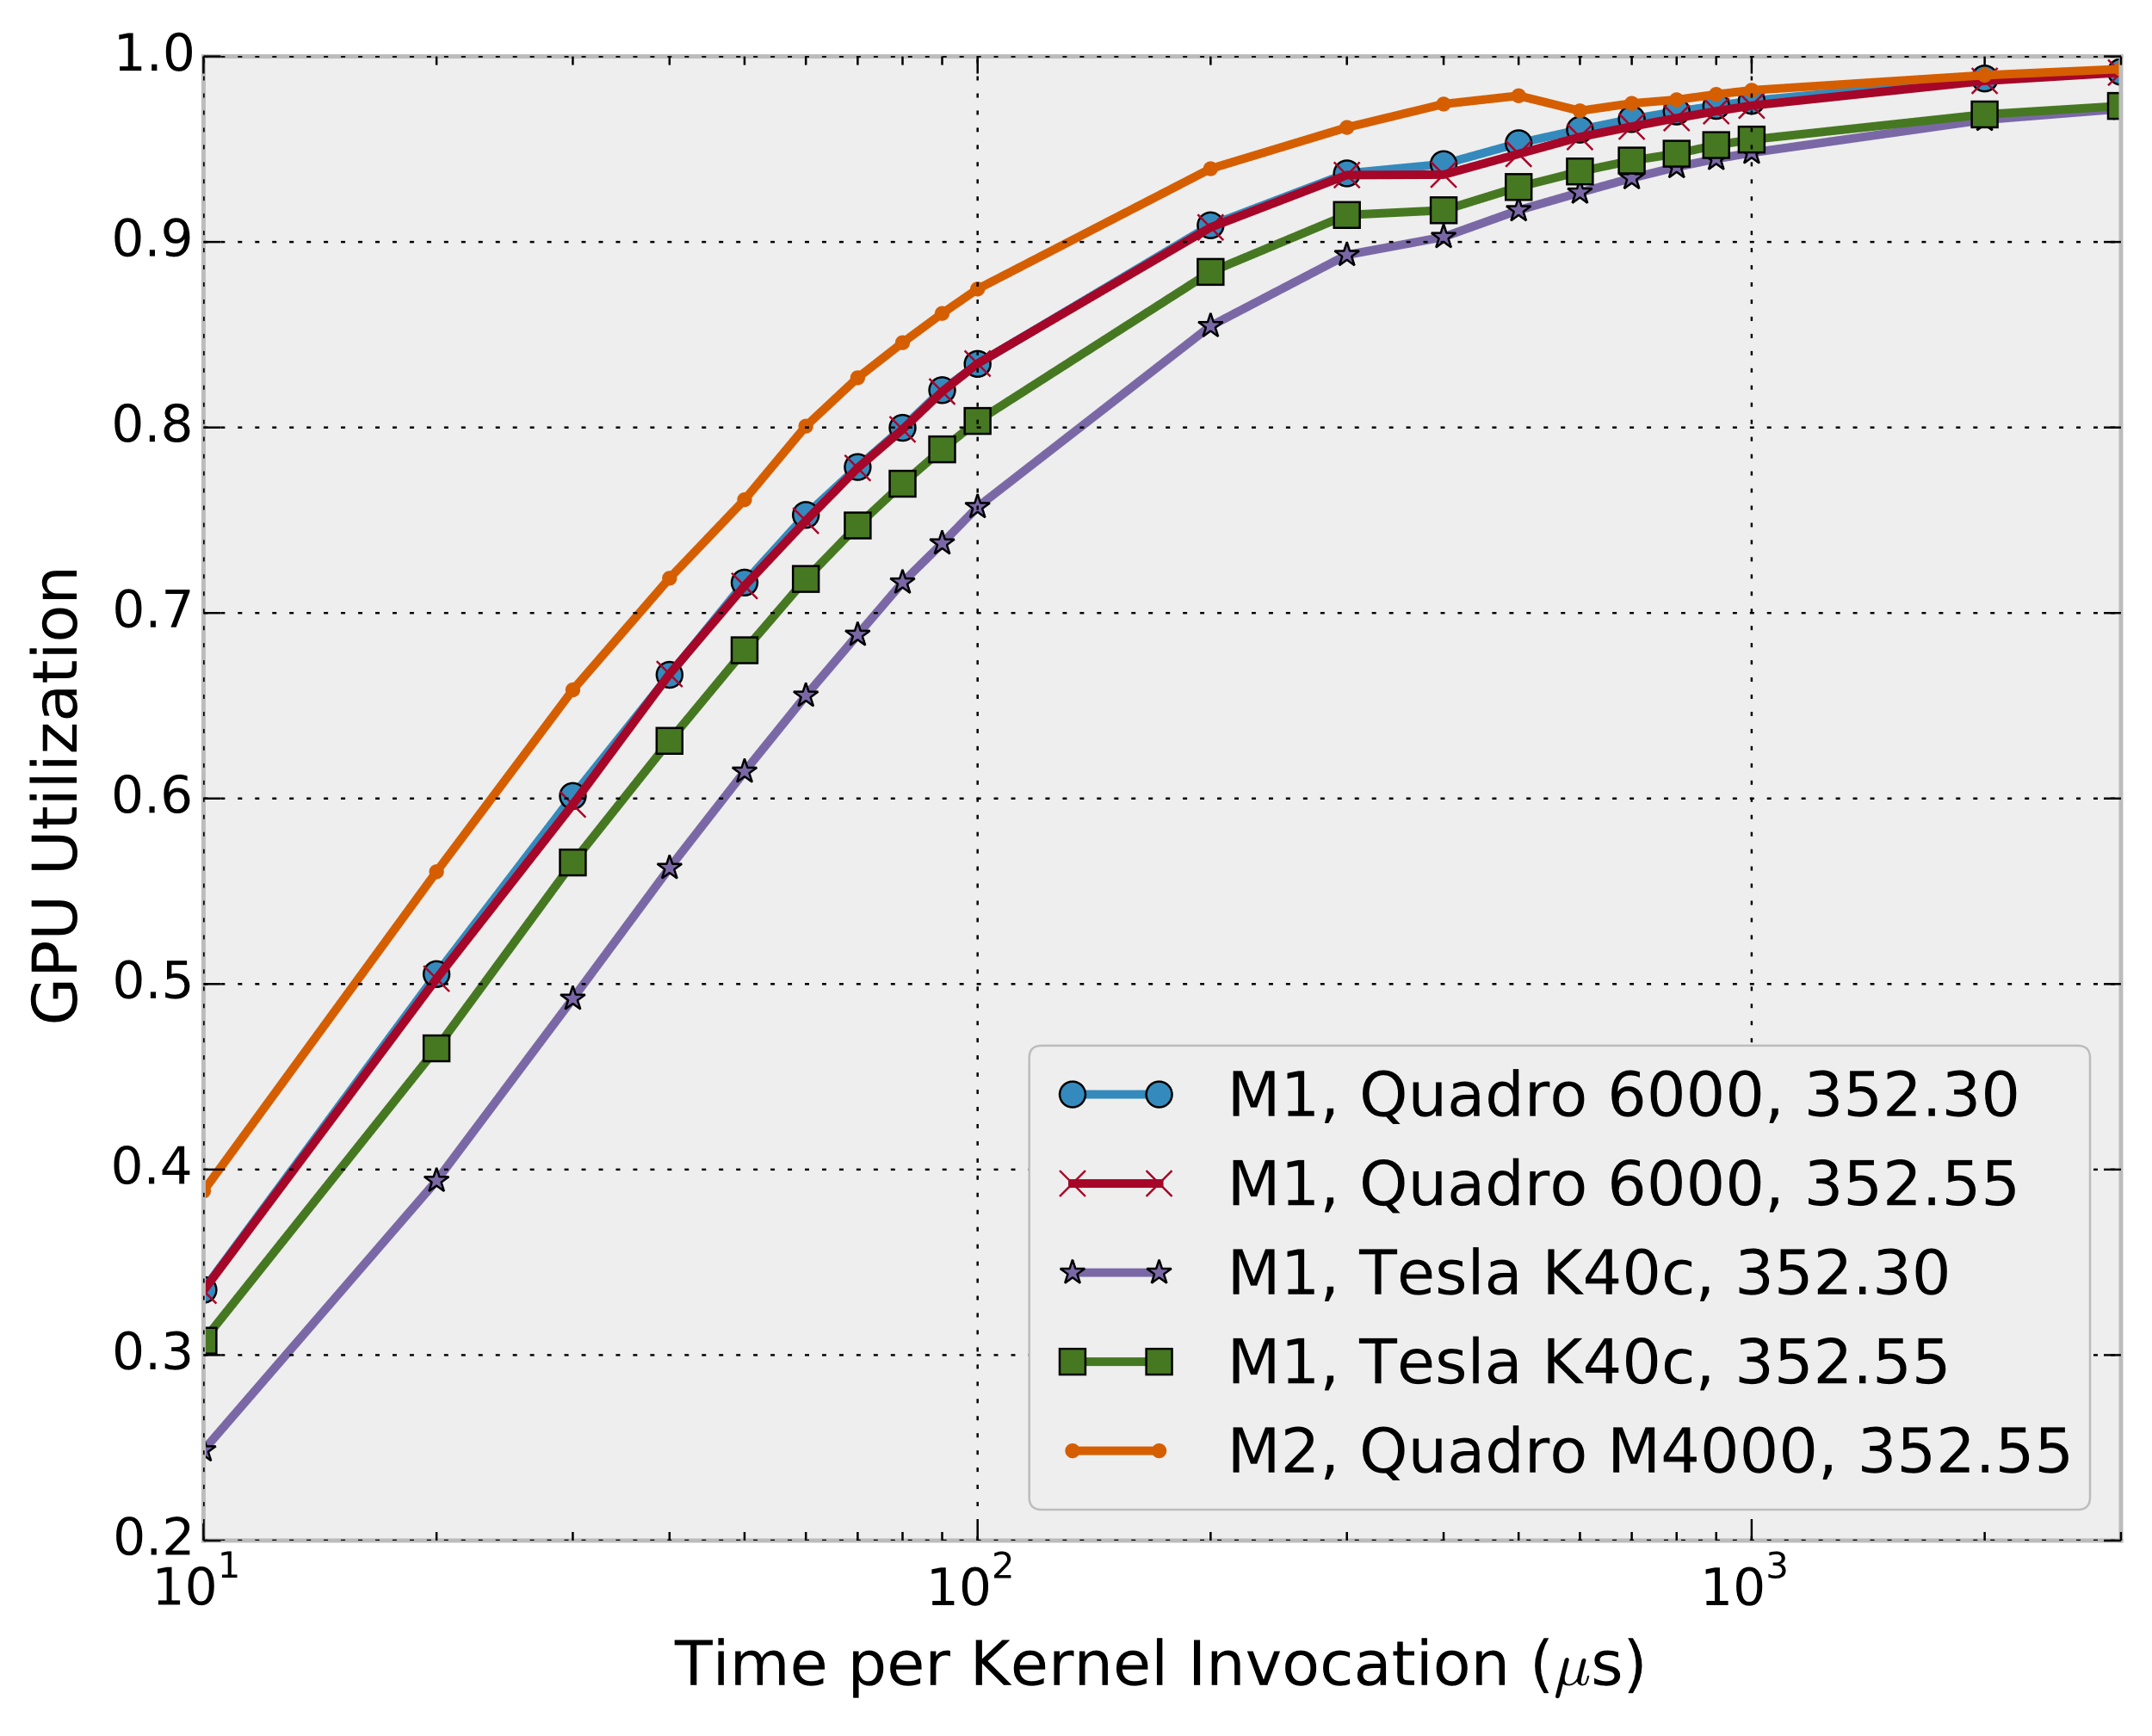
GPU Utilization for Short Kernels

Slide 87
Can we avoid short kernels?
Iterative Graph Algorithms use worklists
Current worklist depends on previous one
Can't batch work to increase length
Ironically, optimizing kernels is harmful!
The shorter the kernel, the more it suffers

Slide 88
Iterative Algorithm Timeline
CPU
GPU
CPU
GPU
launch
launch
bfs
bfs
Idling
bfs
bfs
bfs
Idling
bfs
bfs
Control Kernel
Idling
bfs
Time
Time

Slide 89
Iteration Outlining
“Outline” Iterate to GPU
Results in a single “control” kernel
Converts Kernel Launches to Function Calls
Launch control kernel once from CPU
Only returns to CPU once all iterations complete
Kernels in Iterate invoked via function calls on GPU

Slide 90
Summary
IrGL compiler performs 3 key optimizations
Cooperative Conversion
reduces atomics in lock-free data-structures
Nested Data Parallelism
reduces serialization
Iteration Outlining
eliminates kernel launch bottlenecks
Allows auto-tuning for optimizations

Slide 91
Results
Eight irregular algorithms
BFS, CC, DMR, MIS, MST, PR, SSSP, TRI
Tesla K40 GPU
Baselines were state-of-the-art implementations
Graphs
Road Networks: USA, CAL and NY
RMAT (synthetic): RMAT22, 20 and 16
Grid (1024x1024)
Meshes: 10M points, 5M points, 1M points

Slide 92
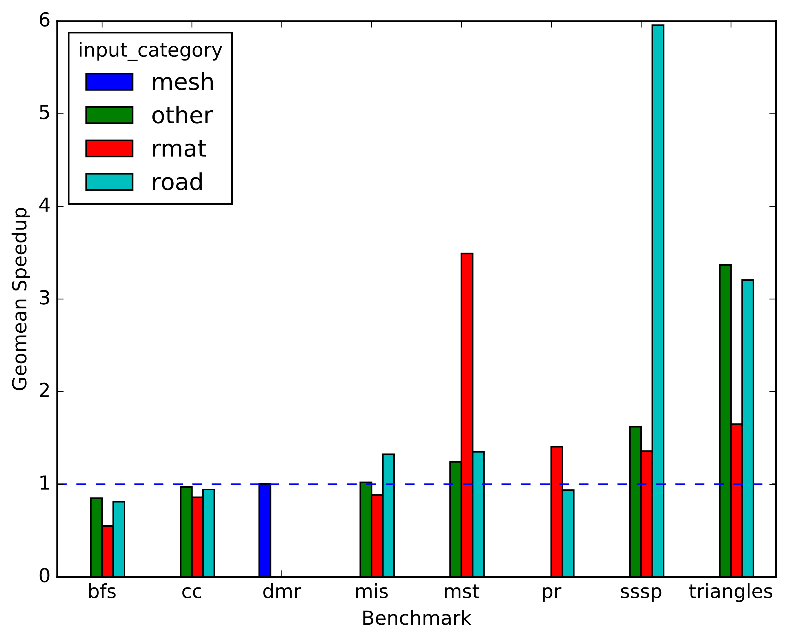
Overall Performance
Best
Handwritten
Code
Note: Each benchmark had a single set of optimizations applied to it

Slide 93
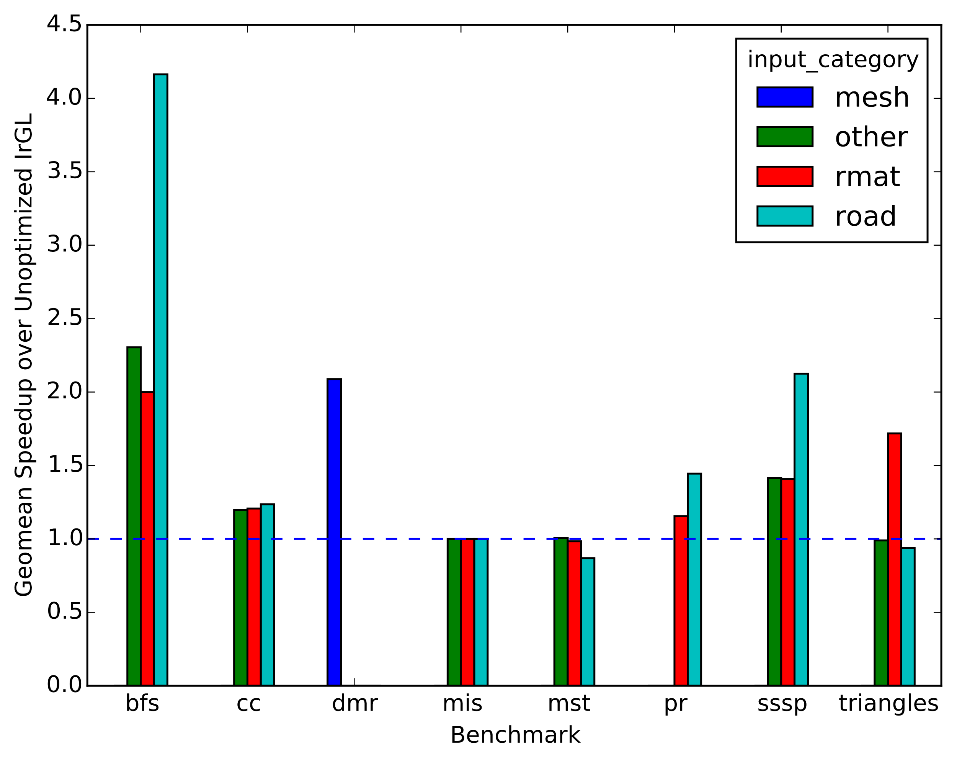
Contribution of Optimizations
Unoptimized
IrGL

Slide 94
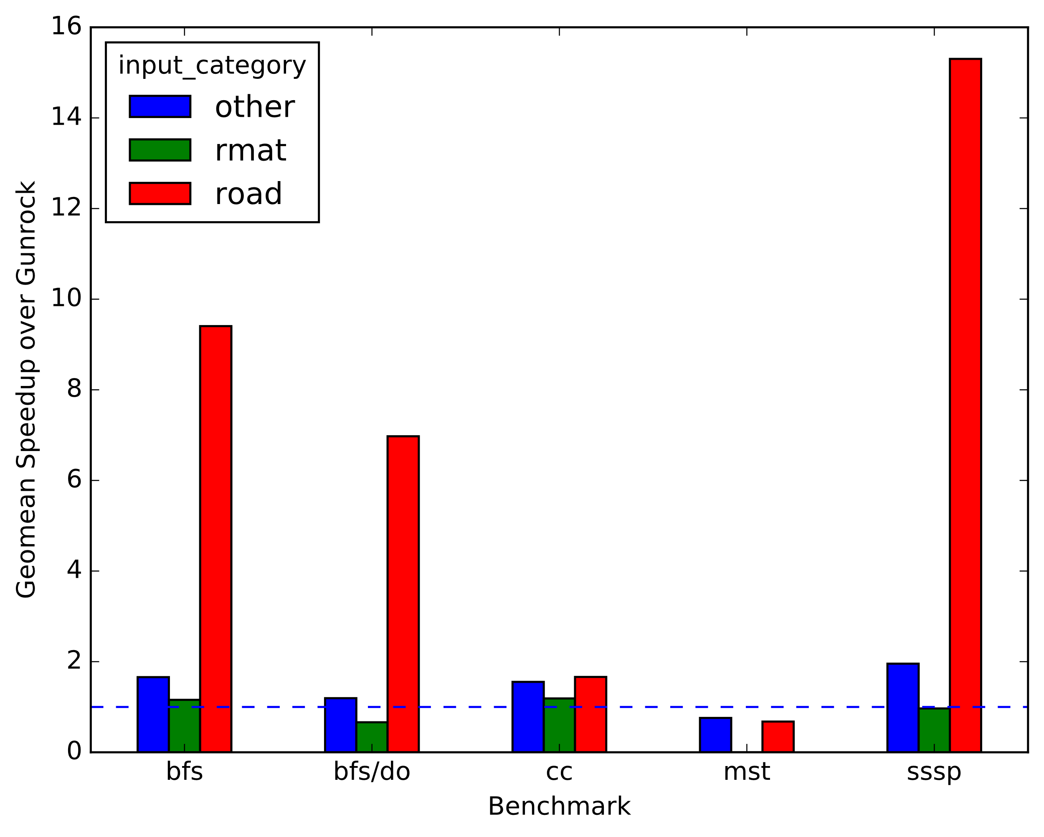
Comparison to Gunrock*
Gunrock
* Wang et al., Gunrock: A high-performance graph processing library on the GPU, PPoPP 2016

Slide 95
Understanding Performance
Graph program performance is poorly understood
Interaction of algorithm, input, implementation and hardware
Our compiler allows controlled experiments
Led to queuing model of graph programs

Slide 96
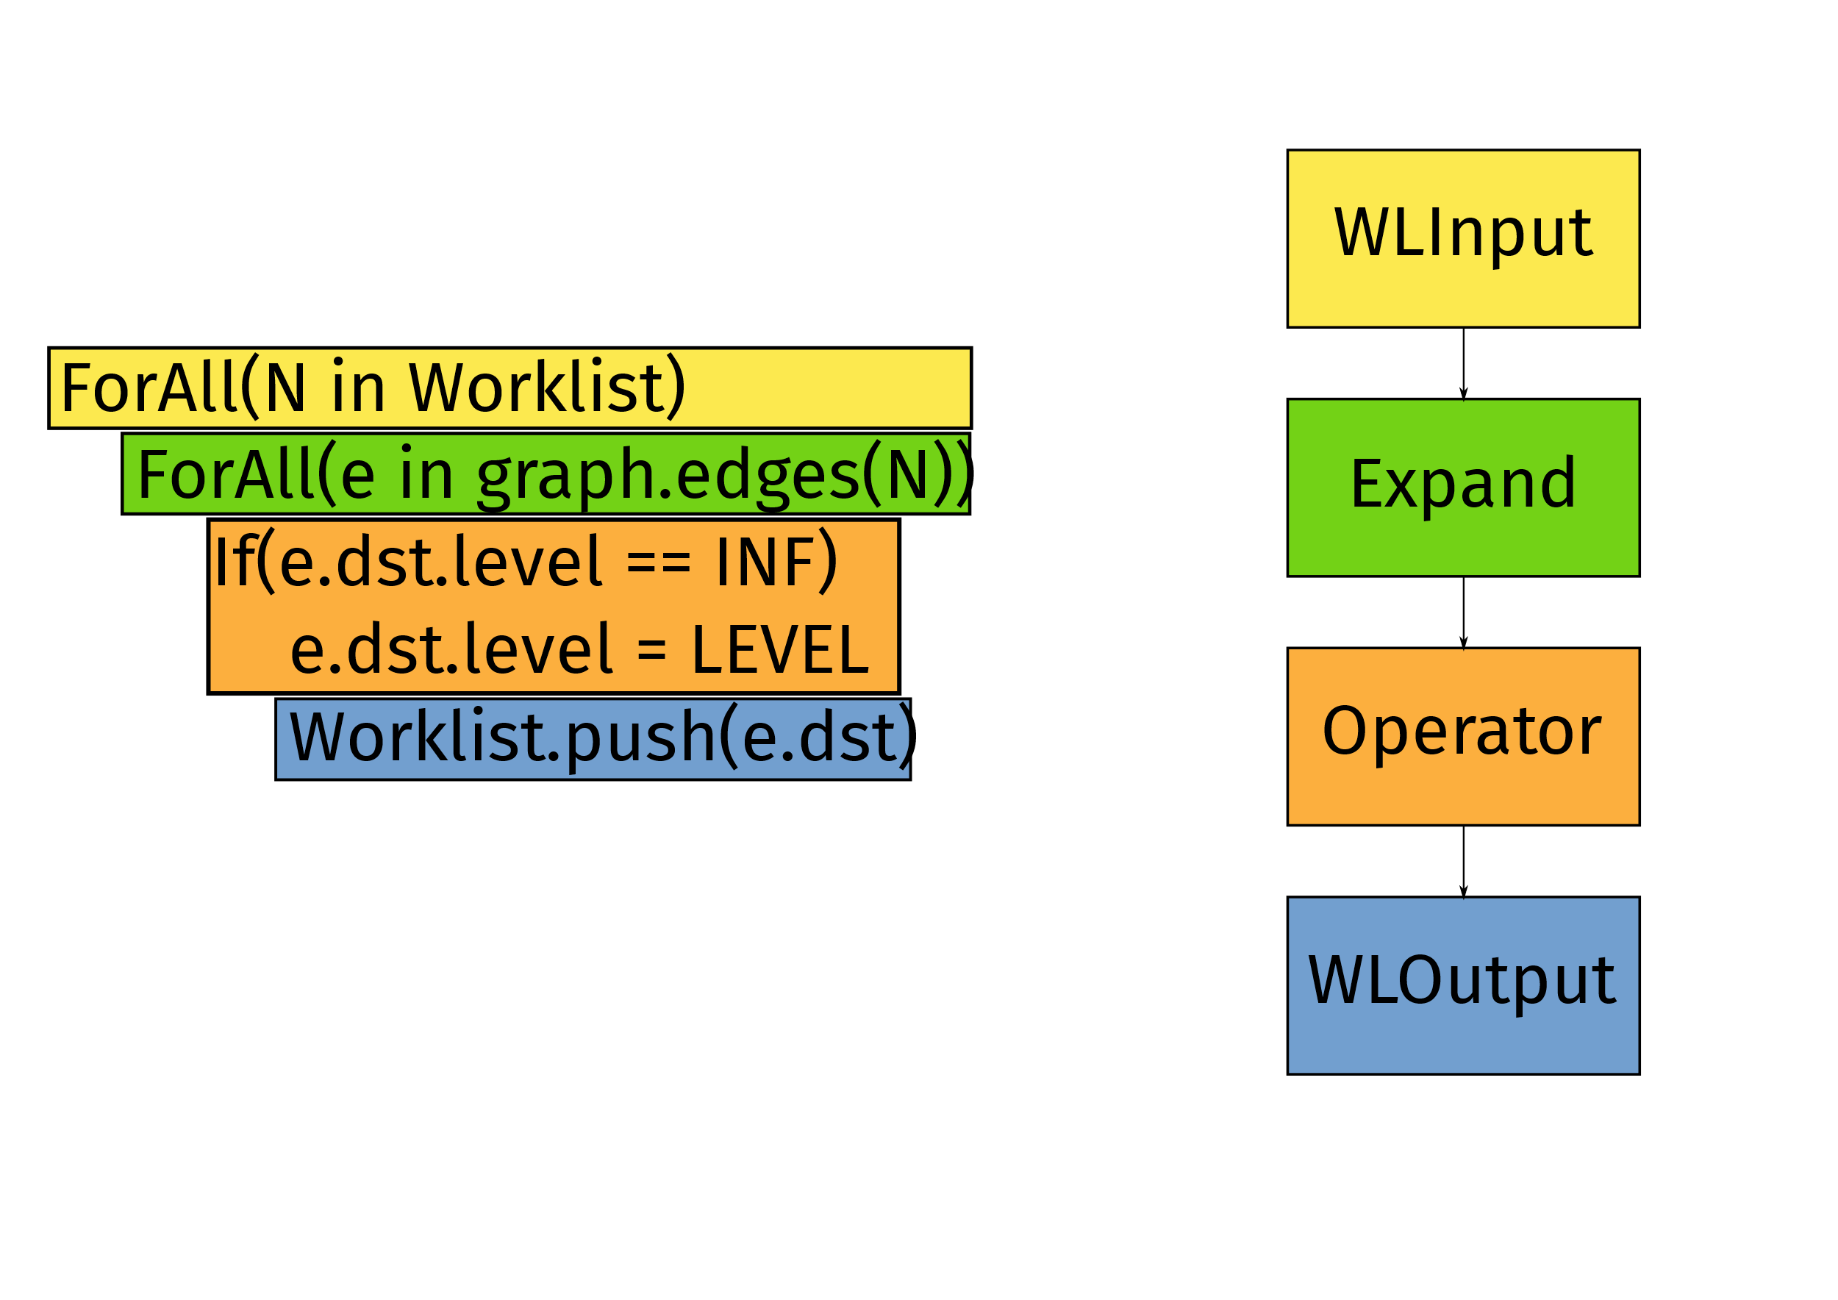
BFS as a Queuing Network

Slide 97
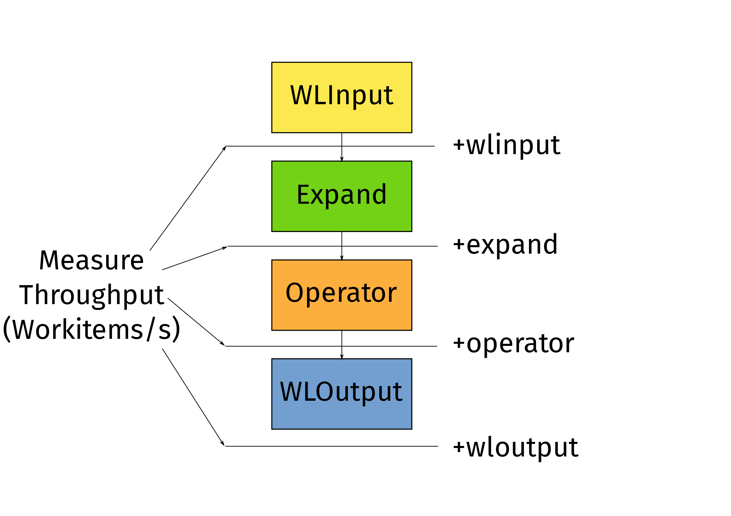
Microbenchmarking Peak Performance

Slide 98
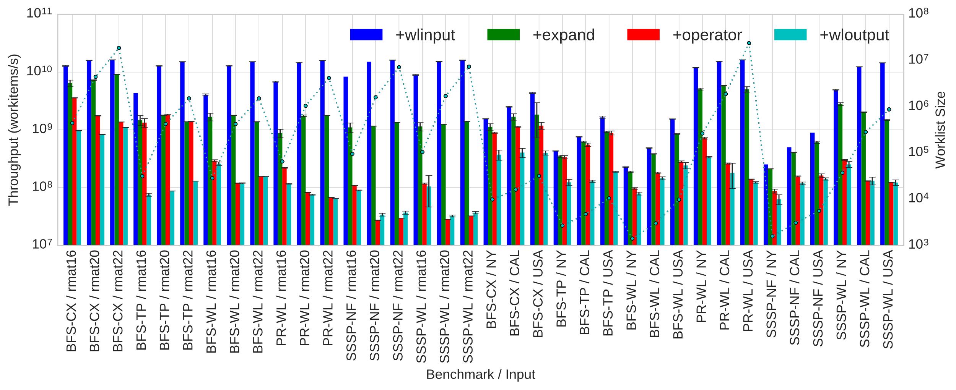
Peak Performance

Slide 99
Ongoing Work
Generate OpenCL from IrGL
With Tyler Sorensen and Alastair Donaldson (Imperial College London)
Generate IrGL from (Simplified) C++
With Andrew Lenharth, Roshan Dathathri and Gurbinder Gill (UT Austin)
Compile Graph Database Query languages (Apache Tinkerpop/Gremlin) to IrGL
Analytical Performance Models and Profile-Guided Optimization of IrGL programs

Slide 100
Conclusions
Graph algorithms on GPUs need three optimizations for high performance:
Cooperative Conversion (reduce atomics)
Nested Parallelism (reduce serialization)
Iteration Outlining (improve utilization)
These optimizations can be automated by a compiler
Our IrGL compiler implements these optimizations
Median speedup: 1.4x, upto 4.2x speedup

Slide 101
Thank you!
Questions?
sreepai@ices.utexas.edu

Slide 102
Short kernels or Launch overheads?
SSSP | Bellman-Ford |  | Near--Far
Input | NY | USA | NY | USA
Iterations | 813 | 5792 | 1893 | 49216
Avg. iteration time (µs) | 88.17 | 9168.5 | 18.5 | 20
Time (ms) | 123 | 53149 | 98.8 | 2536
Time (outlining, ms) | 88.5 | 60954 | 41.7 | 1149
Time (with DP, ms) | 94 | 53600 | 92 | 2448

Slide 103
IrGL
Intermediate representation
Represents irregular programs
Slightly higher-level than CUDA
Compiler-managed scheduling
High-level synchronization constructs
First-class Worklist management
Compiles to CUDA

Slide 104
IrGL Worklist Constructs
sssp_nearfar
...
Pipe {
sssp_nearfar(graph)
remove_dups()
}
...
remove_dups
Worklist.push: Pushes work onto a bulk-synchronous style worklist
Iterate and Pipe: Create and route worklists between kernels, looping until worklist is empty

Slide 105
Haven't we seen these before?
Construct | OpenACC | PPCG | OpenMP 4.0 | FALCON | IrGL
ForAll | Y | Y | Y | Y | Y
Atomic | Y | N | Y | Y | Y
Exclusive | N | N | Y | Y | Y
Graph Traversal Microbenchmark | 13ms | 13ms | 63ms | - | 2ms
6.5x faster

Slide 106
A Compiler for Throughput Optimization of Graph Programs*
* To appear in OOPSLA 2016
We wrote an optimizing compiler for IrGL
Three core optimizations:
Cooperative Conversion
Nested Parallelism
Iteration Outlining
Claim: Impossible to write a high-performance GPU graph program without these optimizations (if applicable)

Slide 107
Thread-Level Aggregation
Kernel example(graph, LEVEL)
ForAll(node in Worklist)
size = len(graph.edges(node))
start = Worklist.reserve(size)
ForAll(edge in graph.edges(node))
Worklist.write(start, edge) start++
Change atomicAdd(1) to atomicAdd(size)
Ordinary write
Going from 1 atomic/push to 1 atomic/thread:

